Slide 1
Class Imbalance & RUSBoost
By David Fernandez, Lena Mueller, Jhanvi Patel, Zach Washburn
Notes:
David 1-5
Zach 5– end
Lena – Exercise
Jhanvi – Kahoot

Slide 2
Class Imbalance
Unequal distribution of classes in the training data set
Classes are biased or skewed
Leads to poor predictive performance, especially for the minority class

Slide 3






Imbalanced Classification
Slight imbalance:
Severe imbalance:
*Can vary across problems

Slide 4
Challenges of Imbalanced Classification Cont.
Minority Class (12:15)
Minority class is typically the class of most interest
Minority class is hardest to predict because there are less examples of this class
Majority Class (12:15)
A naive application of this model might focus on learning the characteristics of the majority class which can “swamp” the minority class
ML Algorithms for classification predictive models are designed for problems that assume equal distribution of classes

Slide 5


Causes of Class Imbalance
Collecting Data Samples
Biased Sampling
Measurement errors
Data collected from narrow geographic regions
Errors made when collecting data
Properties of the Domain
Natural occurrence of presence in one class
Fish vs Sharks in the sea
Might be expensive to generate observations for one class
The model is required to learn the difference between classes

Slide 6
Examples of Imbalanced Classification
Several classification predictive modeling problems that we want to solve are imbalanced in practice.
Severe imbalance occurs with inherent imbalance with class distribution
Each domain can be framed and explored as imbalance classification predictive modeling. ML practitioners should be aware of the problem and how to address it.
Examples:
Fraud Detection
Claim Prediction
Spam Detection
Outlier Detection
Conversion Prediction

Slide 7
Random Undersampling (RUS) BOOST
New hybrid sampling/boosting algorithm for learning from skewed training data
Attractive alternative for improving classification performance of learners built using imbalance data
Removes examples randomly to achieve a balanced class distribution
Simpler and faster alternative to SMOTEBoost

Slide 8
Advantages of RUSBOOST
Simpler and faster alternative to other techniques (SMOTE, ADA)
Often better than alternatives when improving classification performance
Preferred due to simplicity, speed, and performance
Attractive alternative for improving classification performance of learners built using imbalance data
Combining RUS with boosting overcomes the main drawback of RUS which is the loss of information

Slide 9
Data Sampling and Boosting
Data Sampling
Balances the class distribution in the training set by:
Adding examples of minority classes (oversampling)
Drawback: lead to overfitting
Removing examples from the majority classes (undersampling)
Drawback: loss of information
Boosting
Technique used to improve the performance of any weak classifier
It can be performed by reweighting or resampling
Resamples training data based on assigned weights

Slide 10
Sources
Brownlee, J. (2019, December 22). A Gentle Introduction to Imbalanced Classification. Machine Learning Mastery. https://machinelearningmastery.com/what-is-imbalanced-classification/
Chen, H. H. (2022, January 10). Implementation of RUSBoost. https://rdrr.io/cran/ebmc/man/rus.html
Seiffert, C., Khoshgoftaar, T. M., van Hulse, J., & Napolitano, A. (2010). RUSBoost: A Hybrid Approach to Alleviating Class Imbalance. IEEE Transactions on Systems, Man, and Cybernetics - Part a: Systems and Humans, 40(1), 185–197. https://doi.org/10.1109/TSMCA.2009.2029559

Slide 11
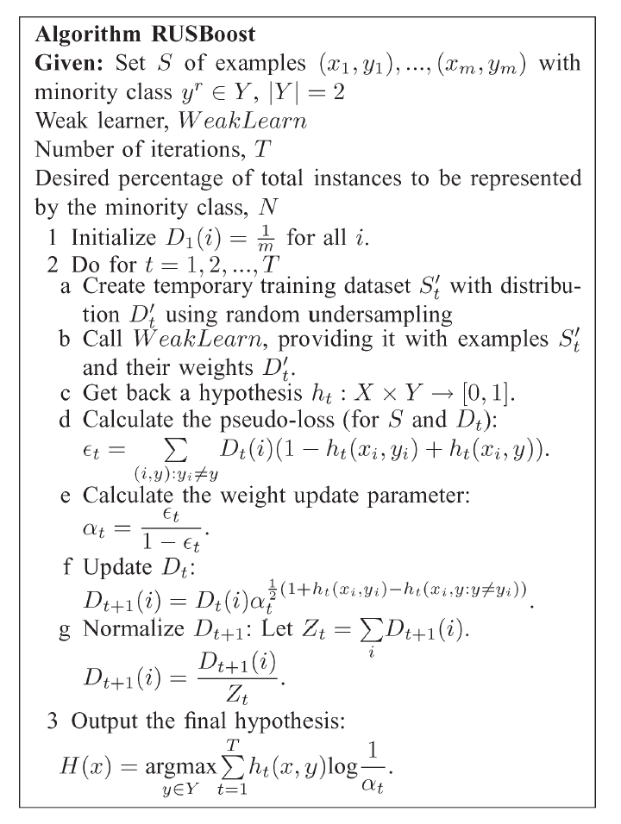
Appendix
RUSBoost Pseudocode (Seiffert et al., 2010)

